Slide 1
Basic Computation
Chapter 2 Part 2
Edited by JJ Shepherd

Slide 2
MATH !!!!1!1!!

Slide 3
Arithmetic Operators
Arithmetic expressions can be formed using the +, -, *, and / operators together with variables or numbers referred to as operands.
  When both operands are of the same type, the result is of that type.
  When one of the operands is a floating-point type and the other is an integer, the result is a floating point type.

Slide 4
Arithmetic Operations
Example
If hoursWorked is an int to which the value 40 has been assigned, and payRate is a double to which 8.25 has been assigned
hoursWorked * payRate
is a double with a value of 500.0.

Slide 5
Arithmetic Operations
Expressions with two or more operators can be viewed as a series of steps, each involving only two operands.
  The result of one step produces one of the operands to be used in the next step.
example
  balance + (balance * rate)

Slide 6
Arithmetic Operations
If at least one of the operands is a floating-point type and the rest are integers, the result will be a floating point type.
The result is the rightmost type from the following list that occurs in the expression.
byte --> short --> int --> long
--> float --> double

Slide 7
The Division Operator
The division operator (/) behaves as expected if one of the operands is a floating-point type.
When both operands are integer types, the result is truncated, not rounded.
  Hence, 99/100 has a value of 0.

Slide 8
The mod Operator
The mod (%) operator is used with operators of integer type to obtain the remainder after integer division.
14 divided by 4 is 3 with a remainder of 2.
  Hence, 14 % 4 is equal to 2.
The mod operator has many uses, including
  determining if an integer is odd or even
  determining if one integer is evenly divisible by another integer.

Slide 9
Parentheses and Precedence
Parentheses can communicate the order in which arithmetic operations are performed
examples:
(cost + tax) * discount
(cost + (tax * discount)
Without parentheses, an expressions is evaluated according to the rules of precedence.

Slide 10
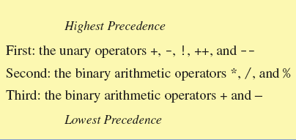
Precedence Rules
Figure 2.2 Precedence Rules

Slide 11
Precedence Rules
The binary arithmetic operators *, /, and %, have lower precedence than the unary operators +, -, ++, --, and !, but have higher precedence than the binary arithmetic operators + and -.
When binary operators have equal precedence, the operator on the left acts before the operator(s) on the right.

Slide 12
Precedence Rules
When unary operators have equal precedence, the operator on the right acts before the operation(s) on the left.
Even when parentheses are not needed, they can be used to make the code clearer.
  balance + (interestRate * balance)
Spaces also make code clearer
  balance + interestRate*balance
  but spaces do not dictate precedence.

Slide 13
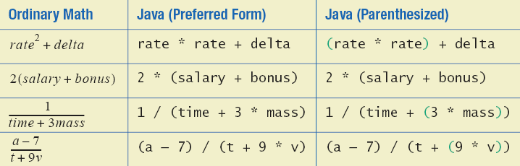
Sample Expressions
Figure 2.3 Some Arithmetic Expressions in Java

Slide 14
Specialized Assignment Operators
Assignment operators can be combined with arithmetic operators (including -, *, /, and %, discussed later).
amount = amount + 5;
can be written as
amount += 5;
yielding the same results.

Slide 15
Case Study:Vending Machine Change
Requirements
  The user enters an amount between 1 cent and 99 cents.
  The program determines a combination of coins equal to that amount.
  For example, 55 cents can be two quarters and one nickel.

Slide 16
Increment and Decrement Operators
Used to increase (or decrease) the value of a variable by 1
Easy to use, important to recognize
The increment operator
  count++ or ++count
The decrement operator
  count-- or --count

Slide 17
Increment and Decrement Operators
equivalent operations
  count++;
  ++count;
  count = count + 1;
  count--;
  --count;
  count = count - 1;

Slide 18
Increment and Decrement Operators in Expressions
after executing
  int m = 4;
  int result = 3 * (++m)
  result has a value of 15 and m has a value of 5
after executing
  int m = 4;
  int result = 3 * (m++)
  result has a value of 12 and m has a value of 5

Slide 19
STRINGS

Slide 20
The Class String
We've used constants of type String already.
  "Enter a whole number from 1 to 99."
A value of type String is a
  Sequence of characters
  Treated as a single item.

Slide 21
String Constants and Variables
Declaring
String greeting;
  greeting = "Hello!";
  or
  String greeting = "Hello!";
  or
  String greeting = new String("Hello!");
Printing
System.out.println(greeting);

Slide 22
Concatenation of Strings
Two strings are concatenated using the + operator.
  String greeting = "Hello";
  String sentence;
  sentence = greeting + " officer";
  System.out.println(sentence);
Any number of strings can be concatenated using the + operator.

Slide 23
Concatenating Strings and Integers
String solution;
solution = "The answer is " + 42;
System.out.println (solution);
The temperature is 72
The answer is 42

Slide 24
String Methods
An object of the String class stores data consisting of a sequence of characters.
Objects have methods as well as data
The length() method returns the number of characters in a particular String object.
  String greeting = "Hello";
  int n = greeting.length();

Slide 25
The Method length()
The method length() returns an int.
You can use a call to method length() anywhere an int can be used.
  int count = command.length();
  System.out.println("Length is " +
  command.length());
  count = command.length() + 3;

Slide 26
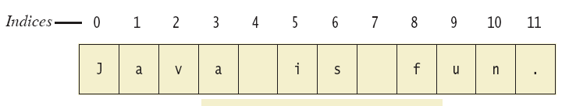
String Indices
Figure 2.4
Positions start with 0, not 1.
  The 'J' in "Java is fun." is in position 0
A position is referred to an an index.
  The 'f' in "Java is fun." is at index 8.

Slide 27
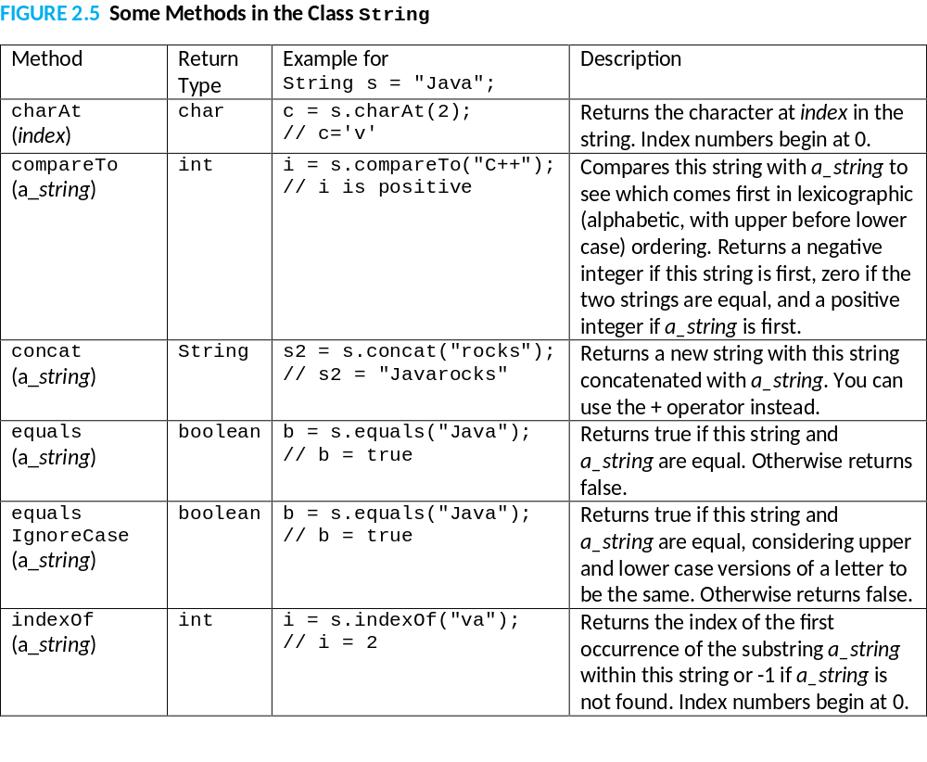

Slide 28
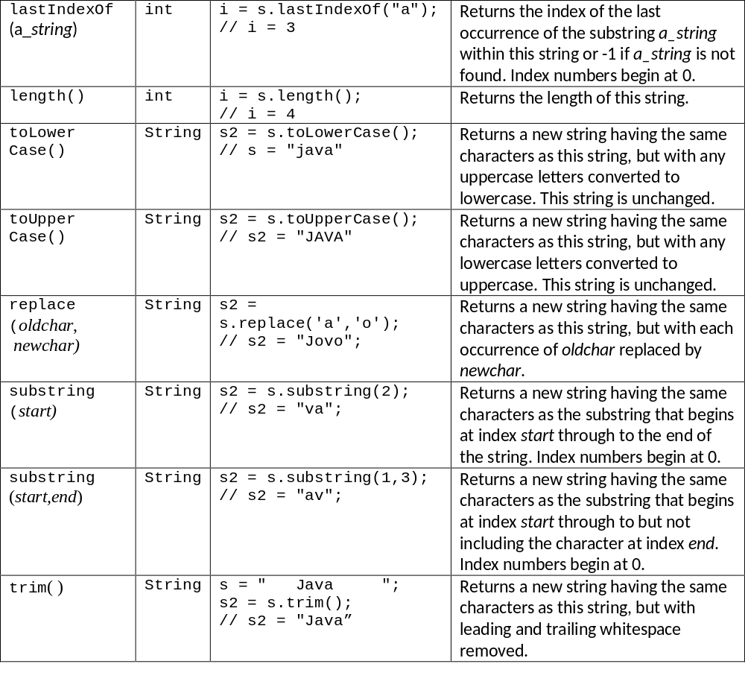

Slide 29
EXAMPLE

Slide 30
Example in more detail
0 | 1 | 2 | 3 | 4 | 5 | 6 | 7 | 8 | 9
B | O | B |  | 2 | 3 |  | 2 | . | 2
input =
Current Line of Code
String input = keyboard.nextLine();

Slide 31
Example in more detail
0 | 1 | 2 | 3 | 4 | 5 | 6 | 7 | 8 | 9
B | O | B |  | 2 | 3 |  | 2 | . | 2
input =
0 | 1 | 2 | 3 | 4 | 5 | 6 | 7 | 8 | 9
B | O | B |  | 2 | 3 |  | 2 | . | 2
copyInput =
Current Line of Code
String copyInput = input;

Slide 32
Example in more detail
0 | 1 | 2 | 3 | 4 | 5 | 6 | 7 | 8 | 9
B | O | B |  | 2 | 3 |  | 2 | . | 2
input =
0 | 1 | 2 | 3 | 4 | 5 | 6 | 7 | 8 | 9
B | O | B |  | 2 | 3 |  | 2 | . | 2
copyInput =
workingIndex = 3
Current Line of Code
int workingIndex = copyInput.indexOf(" ");

Slide 33
Example in more detail
0 | 1 | 2 | 3 | 4 | 5 | 6 | 7 | 8 | 9
B | O | B |  | 2 | 3 |  | 2 | . | 2
input =
0 | 1 | 2 | 3 | 4 | 5 | 6 | 7 | 8 | 9
B | O | B |  | 2 | 3 |  | 2 | . | 2
copyInput =
workingIndex = 3
0 | 1 | 2
B | O | B
name =
Current Line of Code
String name = copyInput.substring(0,workingIndex);

Slide 34
Example in more detail
0 | 1 | 2 | 3 | 4 | 5 | 6 | 7 | 8 | 9
B | O | B |  | 2 | 3 |  | 2 | . | 2
input =
0 | 1 | 2 | 3 | 4 | 5 | 6 | 7 | 8 | 9
B | O | B |  | 2 | 3 |  | 2 | . | 2
copyInput =
workingIndex = 3
0 | 1 | 2 | 3 | 4 | 5
2 | 3 |  | 2 | . | 2
copyInput =
Current Line of Code
copyInput = copyInput.substring(workingIndex+1);

Slide 35
Example in more detail
0 | 1 | 2 | 3 | 4 | 5 | 6 | 7 | 8 | 9
B | O | B |  | 2 | 3 |  | 2 | . | 2
input =
0 | 1 | 2 | 3 | 4 | 5
2 | 3 |  | 2 | . | 2
copyInput =
workingIndex = 3
Current Line of Code
copyInput = copyInput.substring(workingIndex+1);

Slide 36
Escape Characters
How would you print
  "Java" refers to a language. ?
The compiler needs to be told that the quotation marks (") do not signal the start or end of a string, but instead are to be printed.
  System.out.println(
  "\"Java\" refers to a language.");

Slide 37
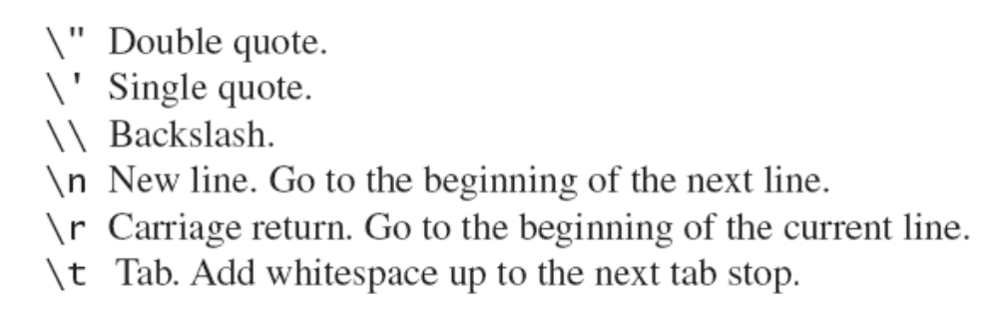
Escape Characters
Figure 2.6
Each escape sequence is a single character even though it is written with two symbols.

Slide 38
Examples
System.out.println("abc\\def");
System.out.println("new\nline");
char singleQuote = '\'';
System.out.println
(singleQuote);
abc\def
new
line
'

Slide 39
The Unicode Character Set
Most programming languages use the ASCII character set.
Java uses the Unicode character set which includes the ASCII character set.
The Unicode character set includes characters from many different alphabets (but you probably won't use them).

Slide 40
Keyboard and Screen
I/O: Outline
Screen Output
Keyboard Input

Slide 41
Screen Output
We've seen several examples of screen output already.
System.out is an object that is part of Java.
println() is one of the methods available to the System.out object.

Slide 42
Screen Output
The concatenation operator (+) is useful when everything does not fit on one line.
  System.out.println("Lucky number = " + 13 +
  "Secret number = " + number);
Do not break the line except immediately before or after the concatenation operator (+).

Slide 43
Screen Output
Alternatively, use print()
  System.out.print("One, two,");
  System.out.print(" buckle my shoe.");
  System.out.println(" Three, four,");
  System.out.println(" shut the door.");
  ending with a println().

Slide 44
Keyboard Input
Java has reasonable facilities for handling keyboard input.
These facilities are provided by the Scanner class in the java.util package.
  A package is a library of classes.

Slide 45
Using the Scanner Class
Near the beginning of your program, insert
  import java.util.Scanner;
Create an object of the Scanner class
  Scanner keyboard =
  new Scanner (System.in)
Read data (an int or a double, for example)
  int n1 = keyboard.nextInt();
  double d1 = keyboard,nextDouble();

Slide 46
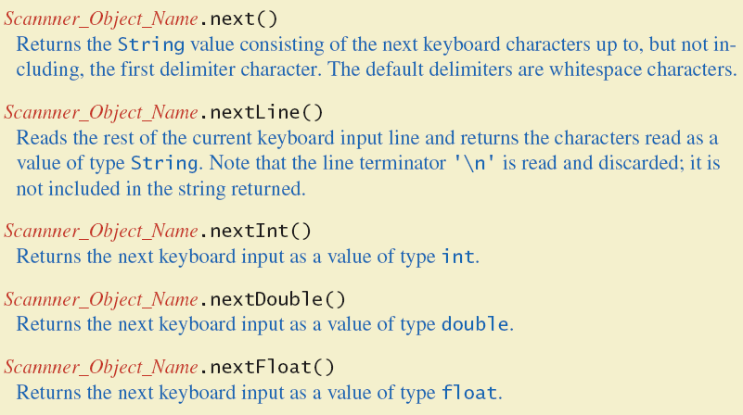
Some Scanner Class Methods
Figure 2.7a

Slide 47
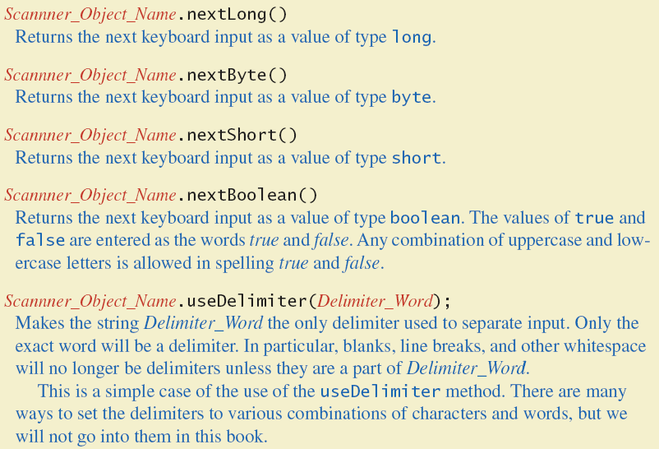
Some Scanner Class Methods
Figure 2.7b

Slide 48
nextLine()Method Caution
The nextLine() method reads
  The remainder of the current line,
  Even if it is empty.

Slide 49
nextLine()Method Caution
Example – given following declaration.
  int n;
  String s1, s2;
  n = keyboard.nextInt();
  s1 = keyboard.nextLine();
  s2 = keyboard.nextLine();
Assume input shown
  n is set to 42
  but s1 is set to the empty string.
  42
  and don't you
  forget it.

Slide 50
The Empty String
A string can have any number of characters, including zero.
The string with zero characters is called the empty string.
The empty string is useful and can be created in many ways including
  String s3 = "";

Slide 51
Other Input Delimiters (optional)
Almost any combination of characters and strings can be used to separate keyboard input.
to change the delimiter to "##"
  keyboard2.useDelimiter("##");
  whitespace will no longer be a delimiter for keyboard2 input

Slide 52
EXAMPLE

Slide 53
Documentation and Style: Outline
Meaningful Names
Comments
Indentation
Named Constants

Slide 54
Documentation and Style
Most programs are modified over time to respond to new requirements.
Programs which are easy to read and understand are easy to modify.
Even if it will be used only once, you have to read it in order to debug it .

Slide 55
Meaningful Variable Names
A variable's name should suggest its use.
Observe conventions in choosing names for variables.
  Use only letters and digits.
  "Punctuate" using uppercase letters at word boundaries (e.g. taxRate).
  Start variables with lowercase letters.
  Start class names with uppercase letters.

Slide 56
Comments
The best programs are self-documenting.
  Clean style
  Well-chosen names
Comments are written into a program as needed explain the program.
  They are useful to the programmer, but they are ignored by the compiler.

Slide 57
Comments
A comment can begin with //.
Everything after these symbols and to the end of the line is treated as a comment and is ignored by the compiler.
  double radius; //in centimeters

Slide 58
Comments
A comment can begin with /* and end with */
Everything between these symbols is treated as a comment and is ignored by the compiler.
  /**
  This program should only
  be used on alternate Thursdays,
  except during leap years, when it should
  only be used on alternate Tuesdays.
  */

Slide 59
Comments
A javadoc comment, begins with /** and ends with */.
It can be extracted automatically from Java software.
  /** method change requires the number of coins to be nonnegative */

Slide 60
When to Use Comments
Begin each program file with an explanatory comment
  What the program does
  The name of the author
  Contact information for the author
  Date of the last modification.
Provide only those comments which the expected reader of the program file will need in order to understand it.

Slide 61
Indentation
Indentation should communicate nesting clearly.
A good choice is four spaces for each level of indentation.
Indentation should be consistent.
Indentation should be used for second and subsequent lines of statements which do not fit on a single line.

Slide 62
Indentation
Indentation does not change the behavior of the program.
Proper indentation helps communicate to the human reader the nested structures of the program

Slide 63
Summary
You have become familiar with Java primitive types (numbers, characters, etc.).
You have learned about assignment statements and expressions.
You have learned about stings.
You have become familiar with classes, methods, and objects.

Slide 64
Summary
You have learned about simple keyboard input and screen output.

